Slide 1
Region 1 Resource Advisor Training
Wilderness, Recreation, and Special Uses

Slide 2
Coordination with Agency Administrator
Delegation of Authority
Example Language
“Coordinate all tactical actions with the assigned Resource Advisors prior to execution. Use Mist Tactics as appropriate on USFS ownership. Motorized and mechanized equipment use in the AB Wilderness must be approved by the Agency Administrator or the Resource Advisor.”

Slide 3
Working with the Team
Preparing for the in-brief
Who’s who – Operations, Planning, Supply
The importance of the morning briefing and the afternoon plans meeting
Using a Resource Advisory in IAP
Spending time on the line

Slide 4
Some see Wilderness as…
A frustrating place to manage fire
A place we can’t use chainsaws or helicopters
Another layer of restrictions
A barrier to timely fire suppression
Notes:
Wilderness values and fire management are not always seen as compatible.

Slide 5
PERCEPTIONS …
All
Wilderness Resource Advisors
Notes:
Tree hugging hippy wilderness ranger….everything is hugs and flowers, hands off approach and everything will
be all right, dude. I just want to hike around.

Slide 6
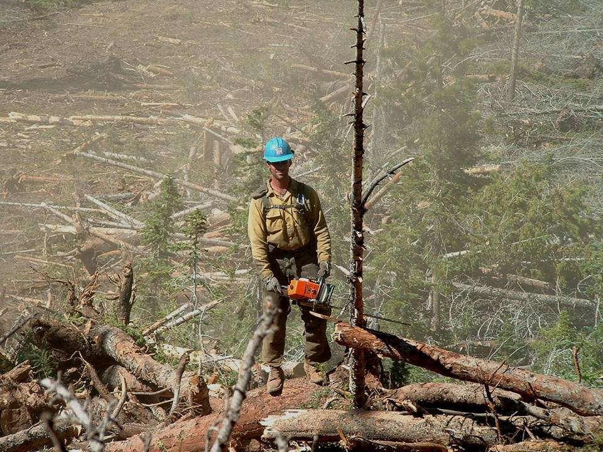
Assumptions...
All
Firefighters
Notes:
One man, one chainsaw, one tree left standing, and even that one is dead, just how we like it! . I imagine this is how most people see us firefighters, that we just want to cut down every tree in the forest, and wage a path of destruction without thinking.
Let’s get some of these misconceptions out of the way. Both firefighters and WRA’s have evolved over the years. Among both groups, many of us see the landscape as the interconnecting, complex system that it is. Many of us have degrees in Forest Management or Natural Resources, and/or many years on the ground existing with the ecosystems we represent.
Physical labor does not make the firefighter stupid, and a love for wild, pristine places does not make the WRA “weak.” In fact, we have more common ground between us than those who choose other careers
we both love wild places
we both respect and admire the forces of nature
nobody here is really in it for the money – it is the desire to make that difference
Lets start our discussion on the footing of this common ground

Slide 7
Wilderness and Fire
Unnecessary, negative impacts from suppression are not part of the natural condition.
Always ask, is this action really necessary?
Manage fire in wilderness using only the minimum necessary actions, tools, and methods.
Notes:
Unnecessary, negative impacts are to be avoided and minimized because they are not part of the natural ecological process.
When the fire is raging and someone proposes to use highly impacting suppression techniques, such as bulldozers, in wilderness it’s important to take a step back and remember what wilderness is all about. Is there a significant reason to use the bulldozers that will actually work? Is the reasoning based on the effects of fire to wilderness or the need to protect lives and property?

Slide 8
Use information and education to:
Provide feasible alternatives to meet both wilderness and fire goals
Capitalize on a ‘teachable moment’ for wilderness
Explain why it matters based on actual effects to the wilderness resource
4. Use “The Authority of the Resource” communication technique
Notes:
The Authority of the Resource techniques is useful to help communicate the wilderness resource message:
Explain WHY the MIST and other techniques and actions are necessary
2. Capitalize on a teachable moment by informing and educating about the wilderness resource to willing recipients.
3. Provide feasible and safe alternatives that meet mutual goals.

Slide 9
Authority of the READ: “I recommend revising the helispot location…”
“Because taking advantage of the natural opening will eliminate the need to fell 20 trees. It’s the minimum necessary action to insure that when we leave here there will be no lasting impacts from our activities.”
“ Because I’m the resource advisor and I have a delegation of authority that empowers me to make these decisions.”
Notes:
Now, using the Authority of the Resource Technique (ART)
Which would you prefer?
Which do you think would get better compliance?
This technique can be used on many issues. Simply by understanding the wilderness resource and explaining the effects of actions we can get others to want to do the right things and adopt a less impacting course of action.

Slide 10
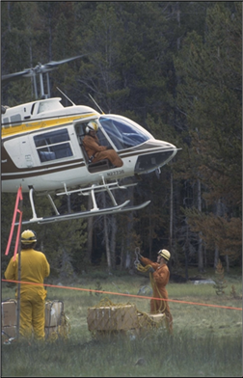
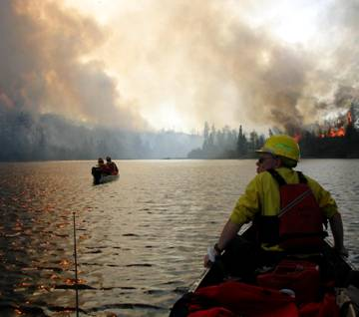
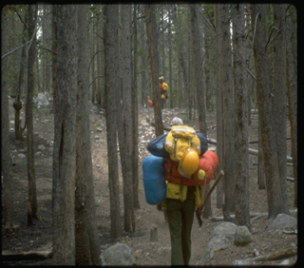
Wilderness Management Determining the Minimum Requirement
Example - Method of transport
Notes:
Mechanical transport and landing of aircraft are prohibited unless they are the minimum necessary. In many areas stock can be used or crews can walk out when they are not immediately needed elsewhere.

Slide 11
Preferences for Limiting Impacts Long term impacts vs. short term disturbances
Aircraft use (if necessary)
Preferred:
Aircraft flights
Helicopter landings and/or sling loads in natural openings
Least acceptable:
New constructed helispots
Notes:
And, it means that if a decision is made that some management action is necessary, some flexibility and consideration of what really causes long term impacts vs. short term disturbance is necessary. For instance a hierarchy of aircraft operations might be like this. Flights and even use of natural openings are temporary and don’t leave a long term impact compared to constructed helispots.

Slide 12
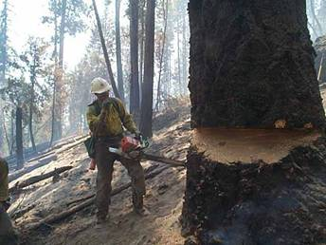
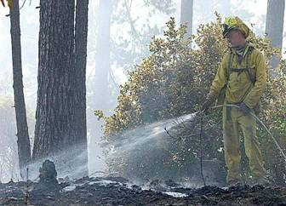
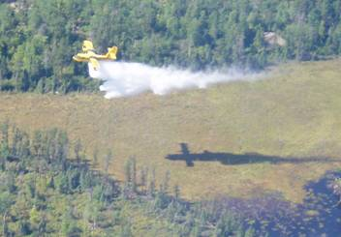
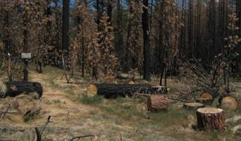
Wilderness Management Determining the Minimum Requirement
Example - Suppression activities
Notes:
Suppression activities may be necessary but can have adverse effects. If possible consider options to avoid dropping the snag or cutting in hard line, especially near trails or water. Spend more time on Step 1, is it necessary to take action (cut the tree)?
Use of a motorized pump is also prohibited in wilderness but may be allowed as a less impacting alternative.

Slide 13
Preferences for Limiting Impacts Long term impacts vs. short term disturbances
Suppression activities (if necessary)
Preferred:
Natural fuel breaks
Cold trailing
Burnouts and backfires
Wetlines and pumps
Least acceptable:
Constructed fireline
Notes:
The use of natural fuel breaks and burning more acres is far more preferable in wilderness that constructed fire line. Even the use of motorized equipment (such as pumps) is no big deal in the long run because there is no lasting impact.

Slide 14
MIST Tactics
Firelines
MINIMIZE cutting of trees, burned trees, and snags.
Use natural barriers such as ridges, meadows, rocky draws, etc.
Use existing trails to backfire or burnout against or to stop fire spread. Try not to widen or cut trench through their natural barriers.

Slide 15
MIST Tactics
Fireline
Limb only what is necessary to prevent fire spread adjacent to fireline.
Inside fireline, cut only those fuels, which would spread fire across the fireline.
Do not cut live trees unless they are a safety hazard or will cause fire to spread across the line.

Slide 16
MIST Tactics
Fireline
On the burnout side of the line, fall only those snags that would spread fire over the line, cause risk of spotting, or pose a safety hazard if they should fall over.
Do not fall snags on the unburned side of the line unless they are an obvious safety hazard to crews or would become firebrand receptacles.

Slide 17
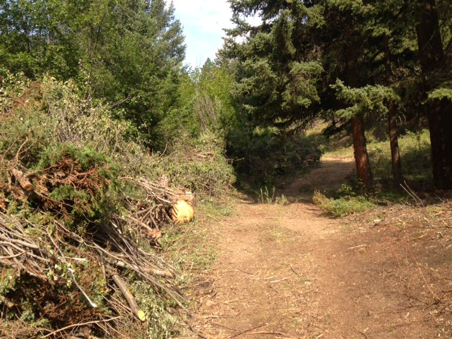

Slide 19
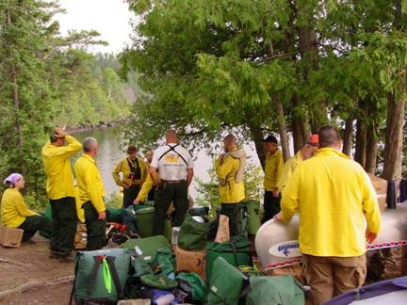
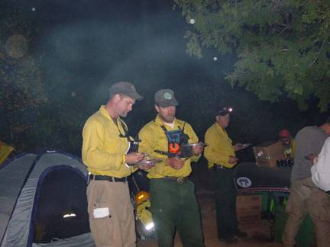
Wilderness Management Determining the Minimum Requirement
Example – Spike and coyote camps
1) Is the camp necessary in wilderness ?
2) What is the minimum necessary development ?
Notes:
Camp activities need to follow the Leave No Trace and minimum impact principles. Use existing sites, avoid any construction of facilities even temporary ones. Use portable toilets, etc.

Slide 20
Spike Camps
Select impact-resistant sites such as rocky or sandy soils or small openings within heavy timber.
Encourage small-scale “coyote-type” camps.
Do not clear vegetation or trench to create bedding sites.

Slide 21
Spike Camps
Change camp location if ground vegetation in the area shows signs of excessive use.
Locate toilet sites a minimum of 200 feet from water sources or existing trails.
Catholes should be least 6-8 inches deep. Dig larger site trenches according to level and duration of use.

Slide 22
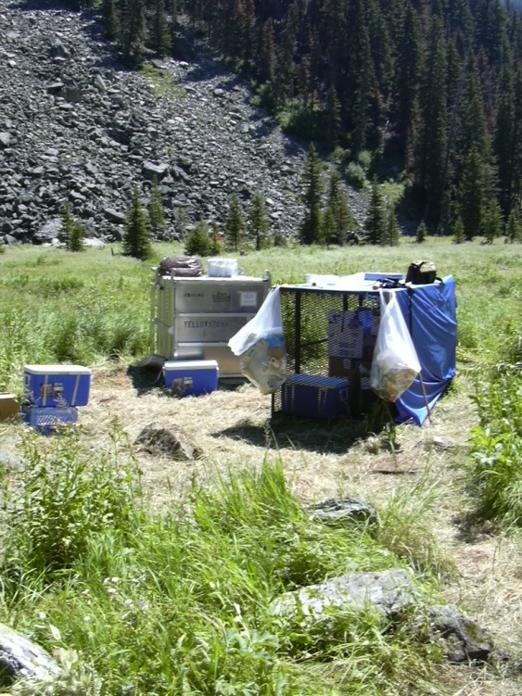

Slide 23
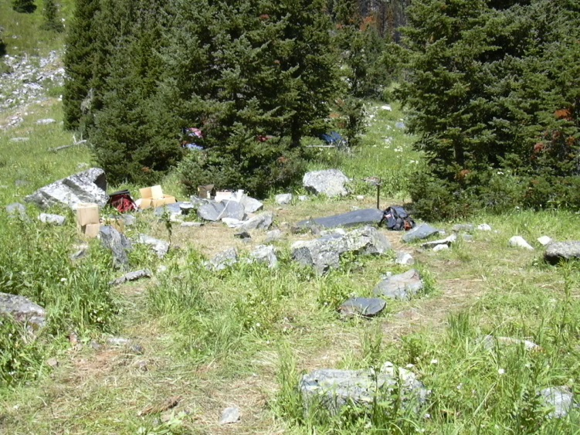

Slide 24
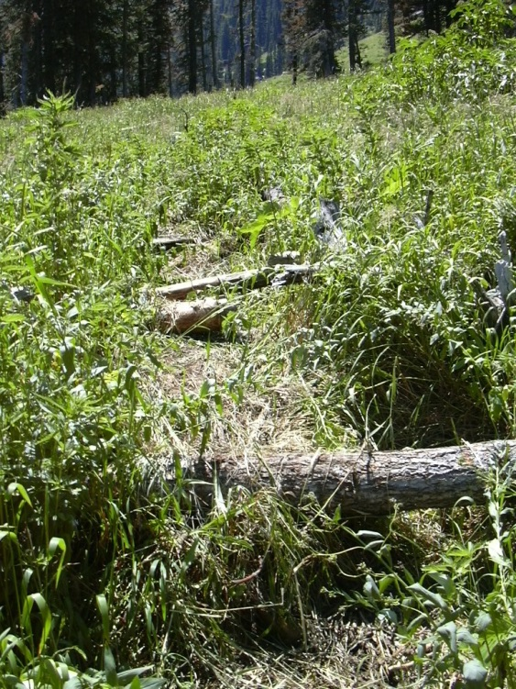

Slide 25
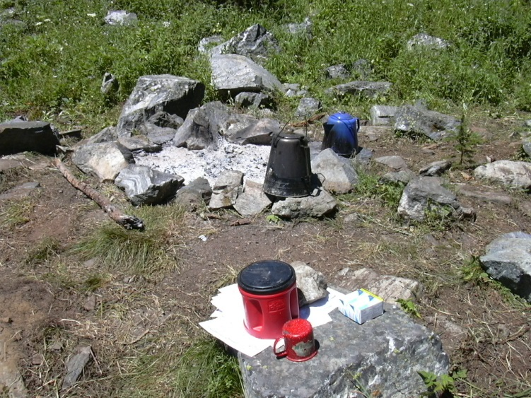

Slide 26
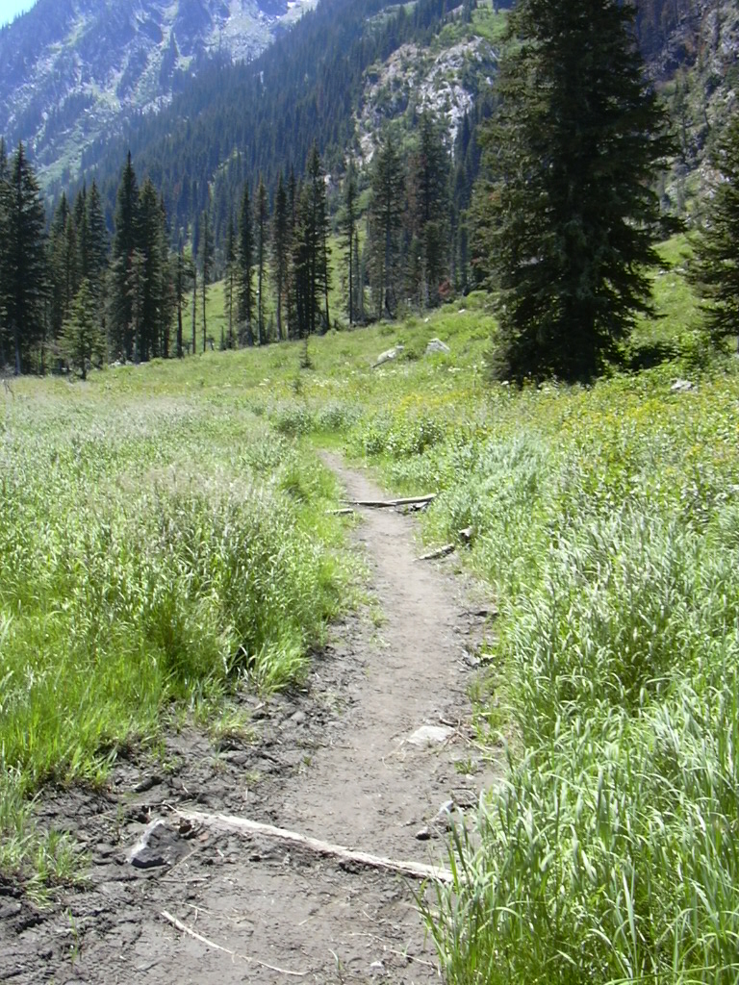

Slide 27
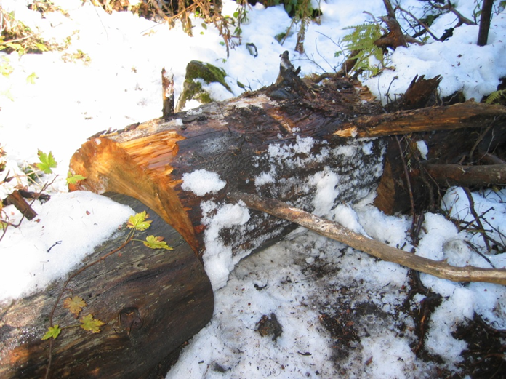

Slide 28
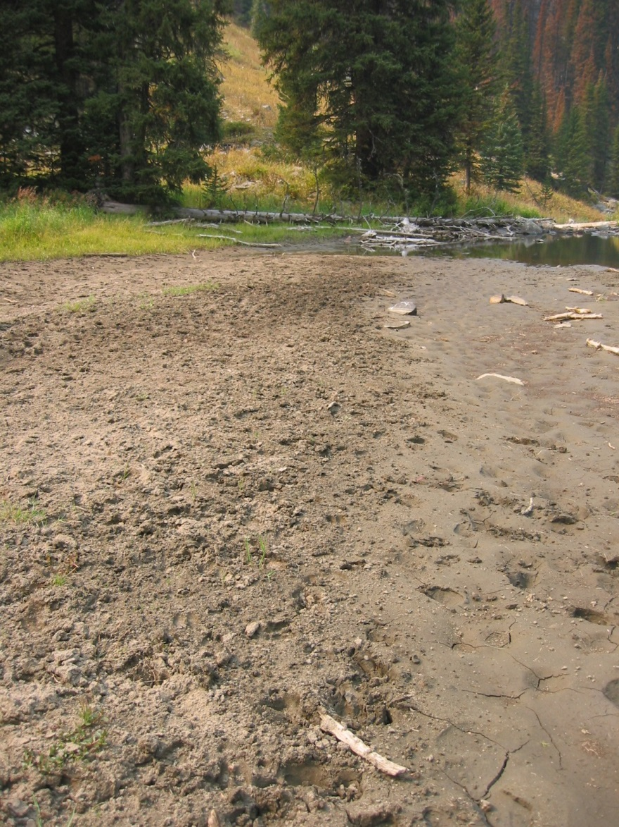

Slide 29
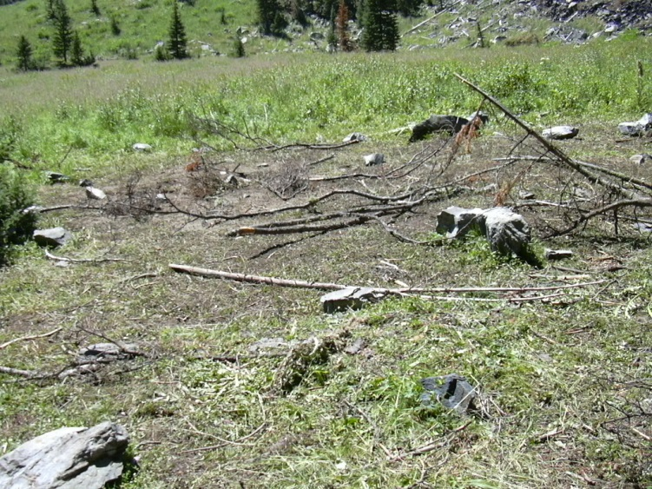

Slide 30
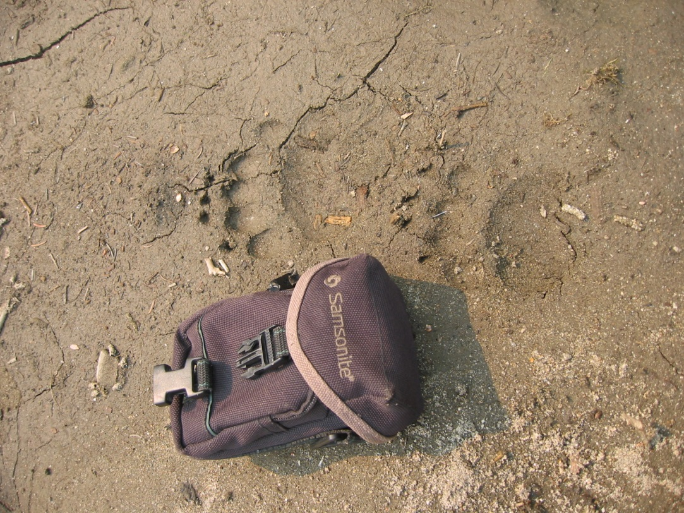

Slide 31
Heli-Spots
Consider using pack animals.
When possible, locate heli-spots outside Wilderness or Wilderness Study Areas.
Use existing natural landing sites when available.
Use long-line to deliver and retrieve gear instead of heli-spots.

Slide 32
Authority for authorizing motorized and mechanized use
Documenting motorized/mechanized authorizations
Working with Aviation to get uses documented
Keep a log of authorizations for chainsaw use, pumps, etc.

Slide 33
Outfitters/Guides
Work with team and WFDSS planning team to identify closure areas and which permit holders are impacted.
Have maps/GIS layers showing the locations of camps and areas used by each outfitter.
Contact outfitters/guides quickly to convey information, discuss closure.

Slide 34
Outfitters/Guides
Develop plan for removing camps if necessary.
Utilize team PAOs to help keep permit holders informed of changing conditions.
Outfitters with pack strings may be helpful to pack in camps, equipment etc to reduce motorized/mechanized use.

Slide 35
Resorts and Org Camps
Work with team and WFDSS planning team to identify closure areas and what permit holders are impacted.
Contact those impacted quickly to convey information and evacuation plans.
Utilize team PAOs to help keep permit holders informed of changing conditions.
Work with Operations and Plans on protection plan for structures.

Slide 36
Campgrounds and Concessionaires
Work with team and WFDSS planning team to identify closure areas and which campgrounds are impacted.
If campgrounds are operated by a concessionaire work together to develop an evacuation plan and implement the plan.

Slide 37
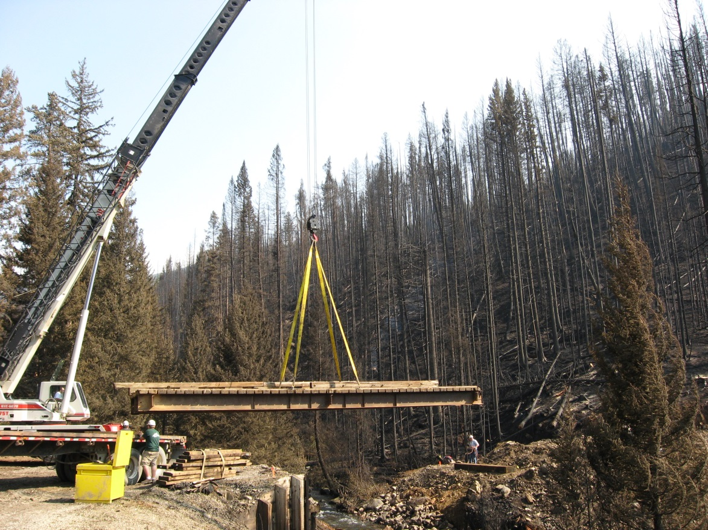
Roads and Trails
Know the locations of expensive infrastructure – bridges especially.
Have maps/GIS layers showing the locations of these structures.

Slide 38
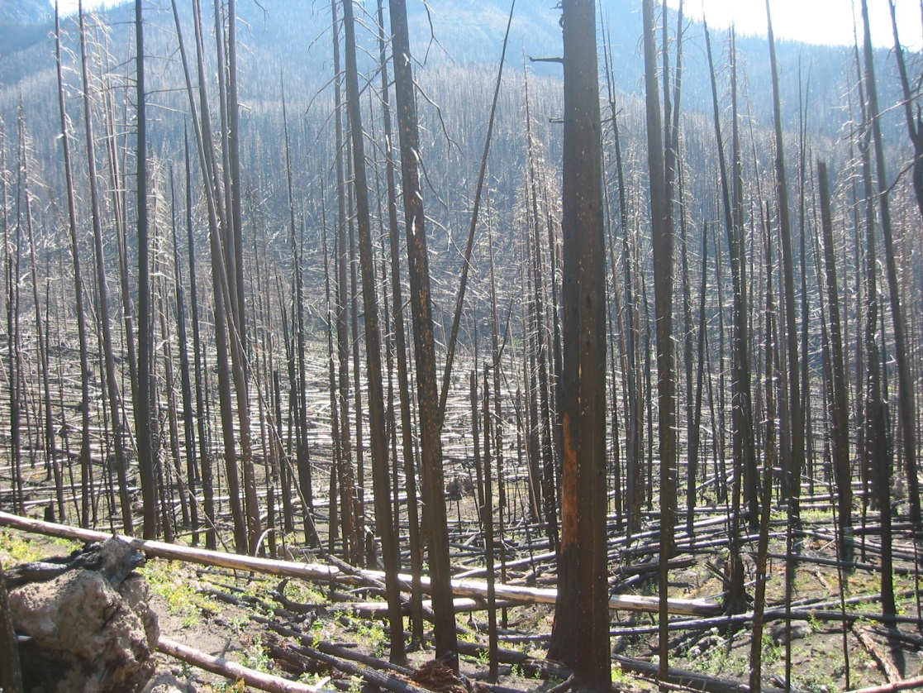
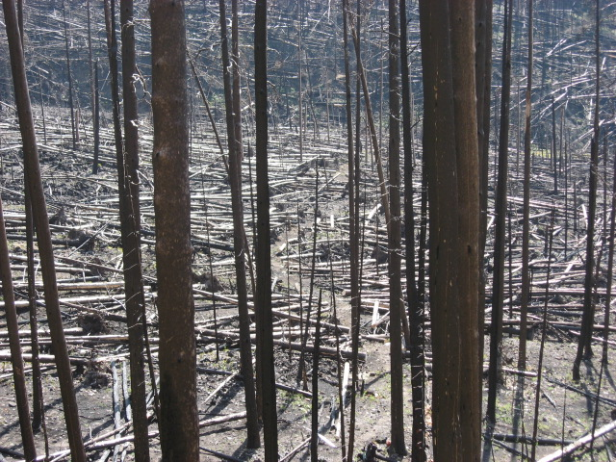
Do Not Despair

Slide 39
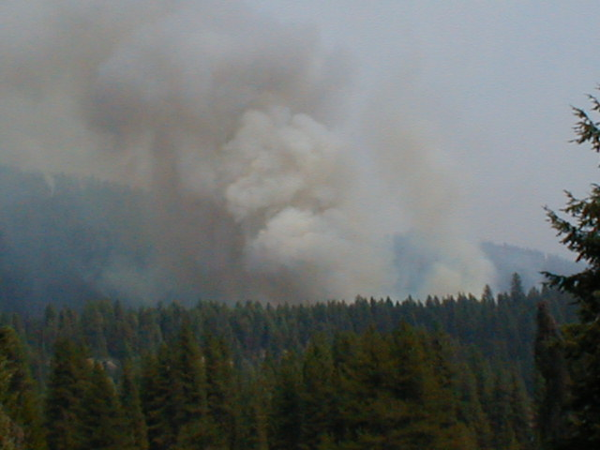
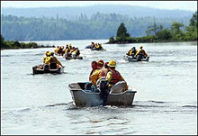
Remember that the essential principle of fire management is always the top priority in wilderness too.
“Do not compromise firefighter or public safety”
Notes:
But, we should never forget the most important part of all fire management activity. Wilderness does not change this.
An essential principle of fire management is safety – no compromise!
A successful wilderness fire management program must incorporate this principle.

